Slide 1
Sampling Primer
Tools for Random Sampling

Slide 2
Goals
Short, pragmatic primer on using tools for sampling sequences
Learn how to efficiently sample datasets with recent tools
Develop critical thinking about how to sample

Slide 3
Prerequisites
Python 3
  Check with which python or which python3
-pip install smof
-pip install smot
Notes:
What computer is everyone using?
Who is following along?

Slide 4
Why do we need sampling?

Slide 5
Why do we need sampling
Down sampling
  Samples can be too many to be computationally feasible
  Ex: Building a tree w/ 50,000 PRRSv sequences
Correction
  Attempt to correct biased sampling
  Ex: 300 closely related taxa in the us compared to 40 disparate seqs globally
Focus
  Not all data may be interesting or relevant
  Ex: Removing classical origin H1 IAV from an H1 hu-seasonal set
  Ex: Extracting PIV3 from mixed PIV dataset

Slide 6
Random Sampling
When is it adequate?
  If you have random “unbiased” data
  Lack of anomalies in data
    Or lack of importance of anomaly
  No specific considerations to the experiment
Sometimes metadata also needs to be considered (i.e. location)
  Often interested in sequence based on location
  Ex Has a strain of H3 IAV been seen on Colorado before?
    Cannot downsample Colorado sequences, but need sequences from other geographies to compare

Slide 7
SMOF
Simple manipulation of fastas
Zeb Arendsee
smof –h
smof sample –h
smof grep -h

Slide 8
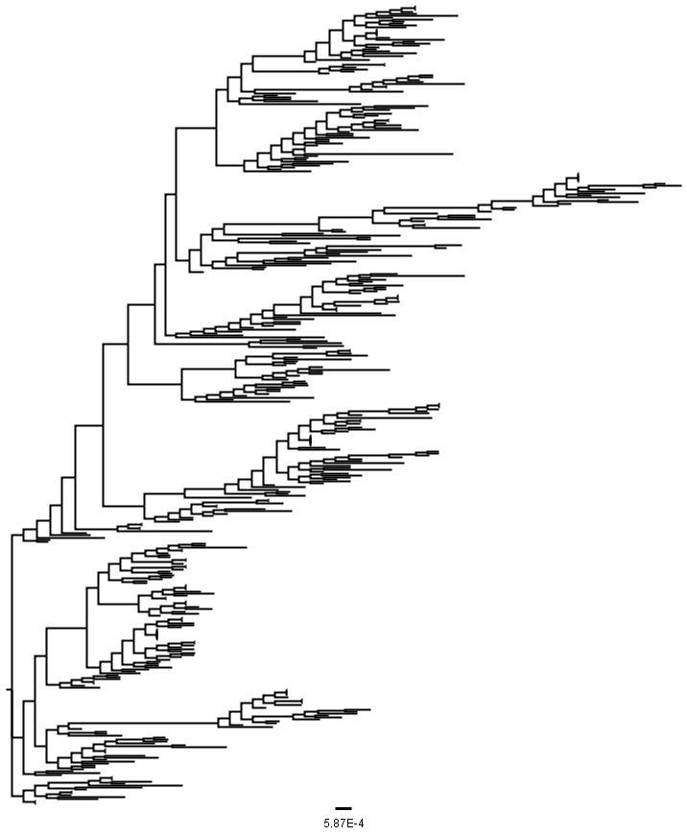
Random Sampling
400 taxa human pdm H1 HA
Scale units is substitutions/site
1701 nt sites
400_human_pdm.fasta

Slide 9
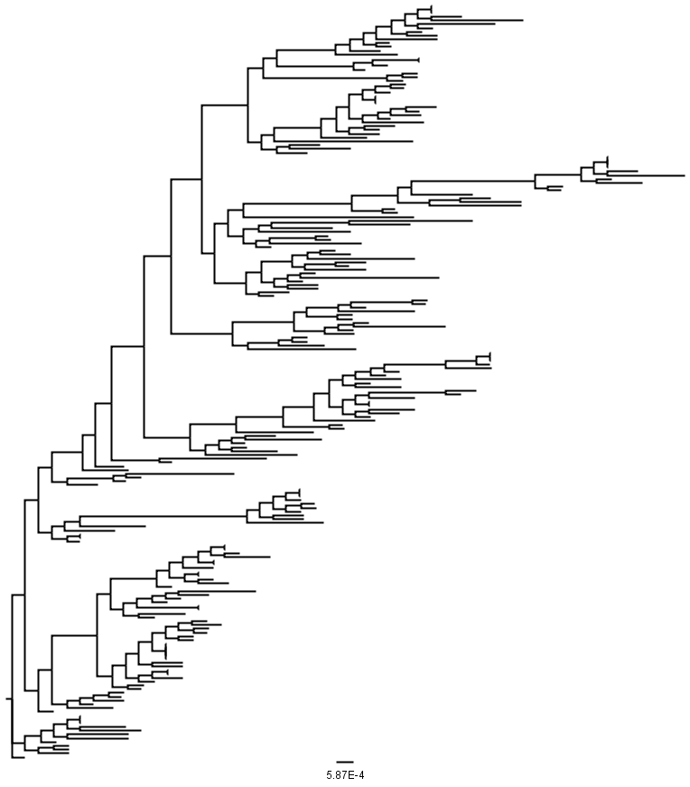
Random Sampling
200 taxa human pdm H1 HA
smof sample –n 200 400_human_pdm.fasta > 200_human_pdm.fasta
[build tree]

Slide 10
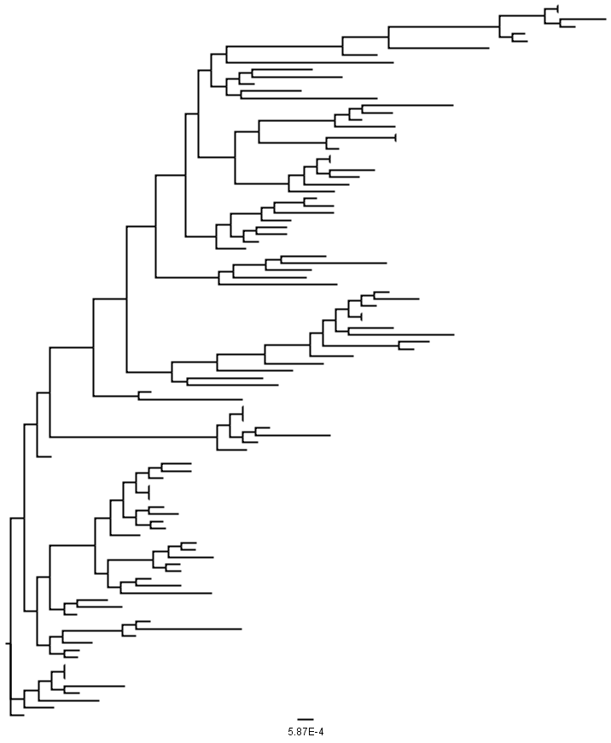
Random Sampling
100 taxa human pdm H1 HA
Topology degrades with less samples under random sampling
smof sample –n 100 200_human_pdm.fasta > 100_human_pdm.fasta
[Build tree]

Slide 11
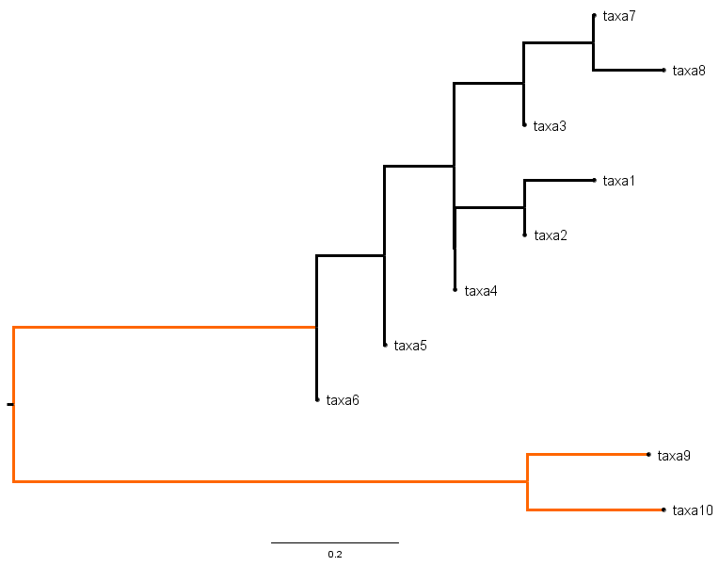
Random Sampling
Heuristics
  If randomly sampling with rare clade, clade size of rare sequence > fold decrease
Example: Taxa 9 and 10 form a unique clade you want to keep in your tree. If you randomly sample half of the tree, what is the probability of maintaining the rare clade?
Notes:
(8 choose 5) / (10 choose 5)
56/252 = 0.22% of getting 2 rare clade

Slide 12


Random Sampling
Random sampling with replacement problem
$$p\left(X=k\right)=\frac{\left(\begin{matrix}m \\ k\end{matrix}\right)\left(\begin{matrix}N−m \\ n−k\end{matrix}\right)}{(\begin{matrix}N \\ n\end{matrix})}$$
If k=1, 55% chance
$$p\left(X=k\right)=\frac{\left(\begin{matrix}2 \\ 2\end{matrix}\right)\left(\begin{matrix}10−2 \\ 5−2\end{matrix}\right)}{(\begin{matrix}10 \\ 5\end{matrix})}$$
If k=2, 22% chance
Notes:
1*56/252

Slide 13
Random Sampling
Best used where topology does not matter
  Broad classification tasks
  High ‘stairness’ to dataset

Slide 14
Even sampling
When is it adequate?
  Demographic analysis
    Dropping ‘rare’ branches may decrease estimated population sizes
  Ancestral reconstructions
  Trying to conserve rare clades

Slide 15
SMOT
Simple manipulation of trees
Zeb Arendsee
smot –h
  color Color the tips or branches.
  factor Impute, annotate with, and/or tabulate factors.
  filter An advanced tool for performaing actions (remove, color, sample,...
  grep Prune a tree to preserve only the tips with that match a pattern.
  sample Subsample the tree using various methods.
  tips Print the tree tip labels.
  tipsed Search and replace patterns in tip labels.
Warning! Smot will not recalculate a tree

Slide 16
Even sampling
400 taxa

Slide 17
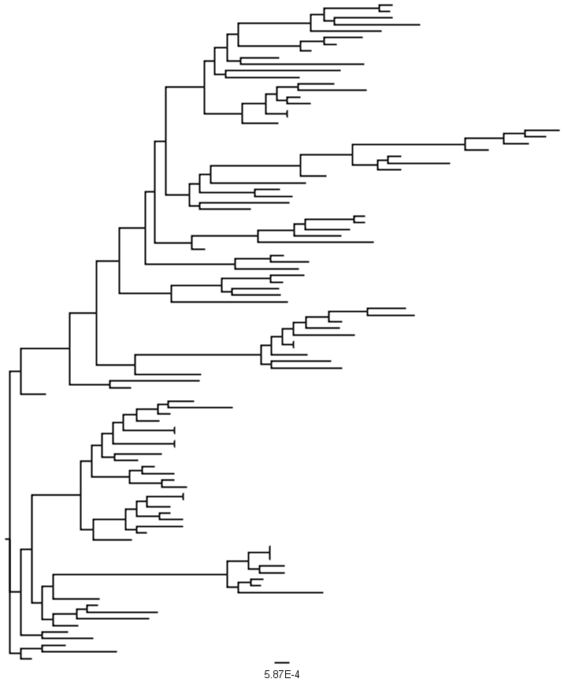
Even sampling
100 taxa
Random sample
Proportionally sample

Slide 18
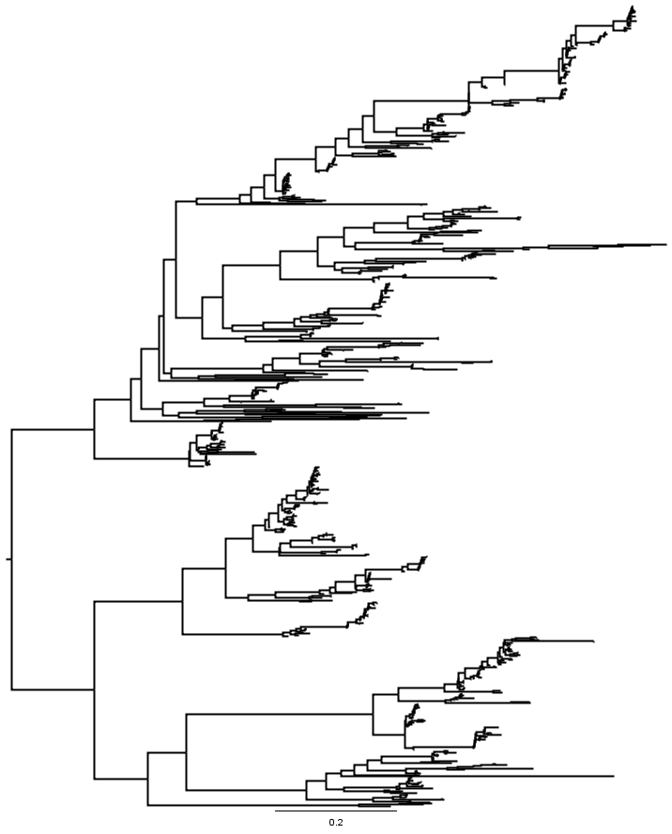
Even sampling
Topology maintained better
Working Example: Picornaviradae
  Working dataset has 800 taxa of RdRp – very stable gene
  Desire to maintain topological structure
  Reduce to ~ 1/4th size

Slide 19
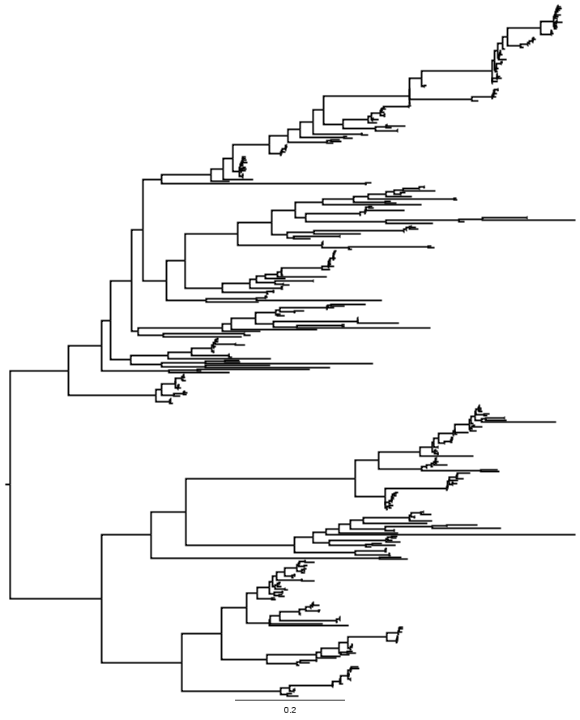
Even sampling
smot -h
smot sample -h
smot sample prop -h
smot sample prop
smot sample prop --min-tips 1 --seed 777 -p 0.5 picorna.tre > fourth_picorna.tre
smot sample prop --min-tips 2 --seed 777 –n 200 picorna.tre > 400_picorna.tre
Flipped, but structure maintained

Slide 20
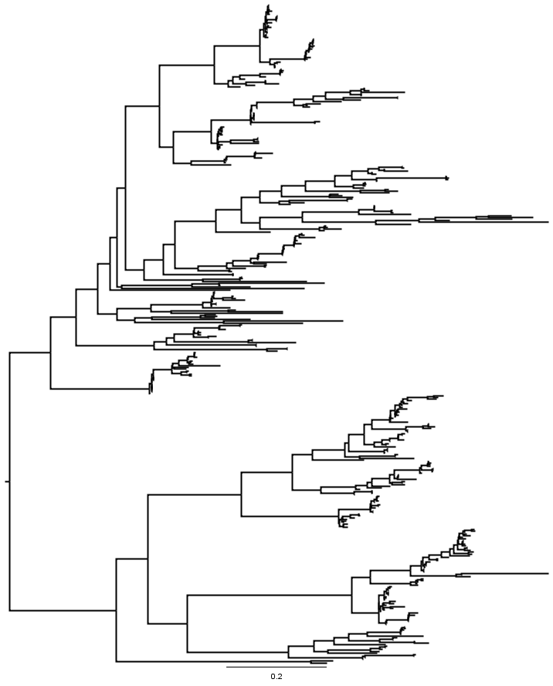
Even sampling
Topology maintenance is better than random sampling
Caveat: Tree had to be rebuilt with random sampling
  If smot selected taxa were rebuilt, topology would be further altered

Slide 21
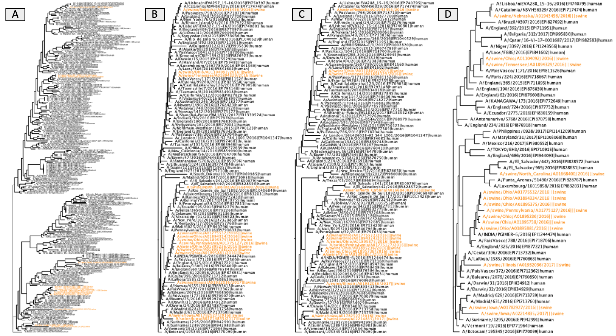
Diff smot options
original
equal
prop
para
Equal
  smot sample equal –h
Para (Paraphyletic sampling)
  smot sample para --min-tips 2 --seed 777 -p 0.25 picorna.tre > para_picorna.tre
From:https://github.com/flu-crew/smot

Slide 22
Focusing on data
Prior methods focused on down sampling or correction
Sometimes need to focus on a subset of data
Extracting sequences via smof grep
Extractign via smot

Slide 23
Extracting sequences by name from FASTA
Ex: We want eonycteris samples from picorna dataset
smof grep -h
smof grep eonycteris picorna.fasta
Ex: Remove murine samples from picorna dataset
smof grep –v murine picorna.fasta

Slide 24
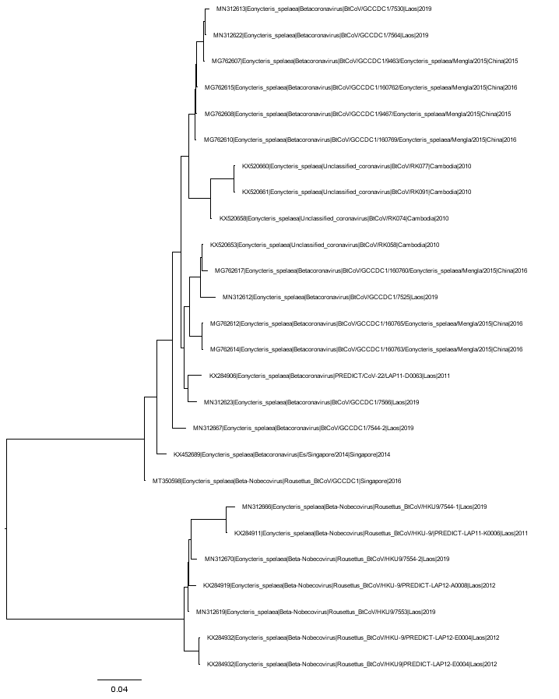
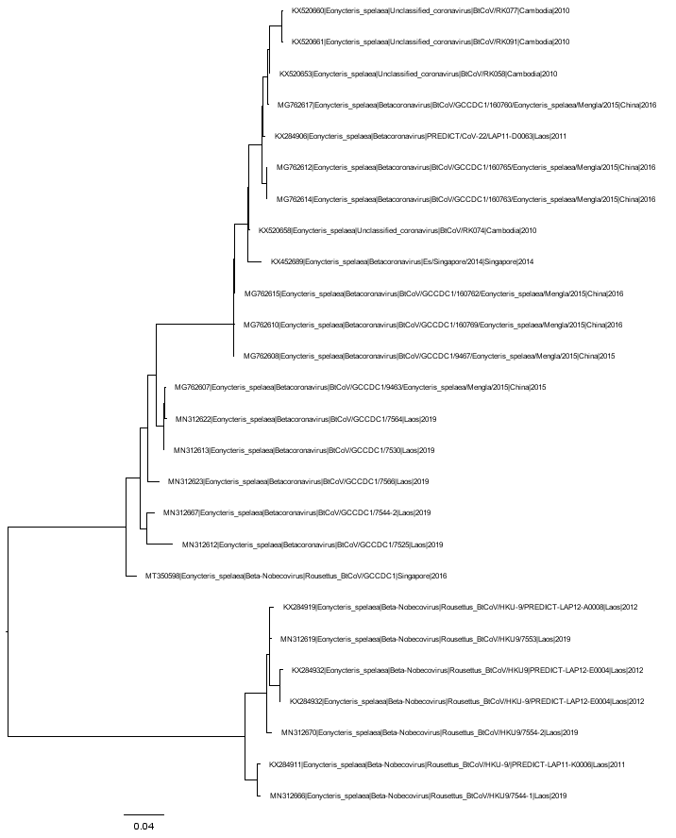
Extracting sequences by name from Tree
smof grep eonycteris picorna.fasta
smot grep Eonycteris picorna.tre

Slide 25
Recap
Random sampling
Sampling evenly along the topology
Selectively sampling the metadata

Slide 26
Questions
Thank you for your time

